Slide 1
Quadrilaterals and Other Polygons
Geometry Chapter 7

Slide 2
This Slideshow was developed to accompany the textbook
  Big Ideas Geometry
  By Larson and Boswell
  2022 K12 (National Geographic/Cengage)
Some examples and diagrams are taken from the textbook.
Slides created by
Richard Wright, Andrews Academy
rwright@andrews.edu

Slide 3
7.1 Angles of Polygons
After this lesson…
• I can find the sum of the interior angle measures of a polygon.
• I can find interior angle measures of polygons.
• I can find exterior angle measures of polygons.

Slide 4
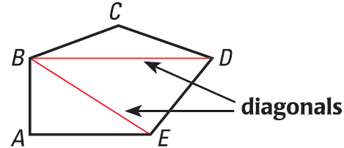
7.1 Angles of Polygons
Polygon
  Closed figure made of straight segments
Diagonal
  Segment that joins nonconsecutive vertices
Notes:
Notice that the pentagon is made into 3 triangles.

Slide 5
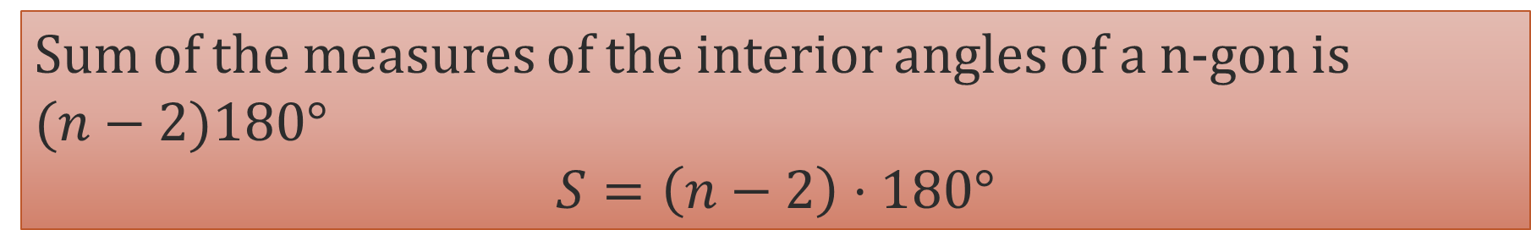
7.1 Angles of Polygons
All polygons can be separated into triangles
The sum of the angles of a triangle is 180°
For the pentagon, multiply that by 3
Polygon Interior Angles Theorem
Sum of the measures of the interior angles of a n-gon is
$(n−2)180°$
$$S=\left(n−2\right)⋅180°$$
Sum of the measures of the interior angles of a quadrilateral is 360°

Slide 6

7.1 Angles of Polygons
The coin is a regular 11-gon. Find the sum of the measures of the interior angles.
The sum of the measures of the interior angles of a convex polygon is 1440°. Classify the polygon by the number of sides.
Try #4, 6
Notes:
S = (n-2)180°
S = (11-2)180° = 1620°
1440° = (n-2)180°
8 = n-2
n = 10

Slide 7
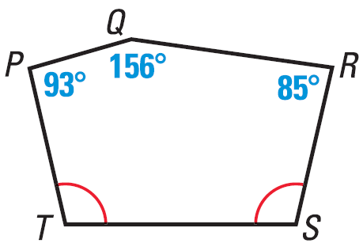

7.1 Angles of Polygons
Find m$∠$T
Try #10
Notes:
93° + 156° + 85° + x + x = 540°
334 + 2x = 540
2x = 206
x = 103

Slide 8
7.1 Angles of Polygons
Equilateral Polygon
  All sides congruent
Equiangular Polygon
  All angles congruent
Regular Polygon
  All sides and angles congruent

Slide 9
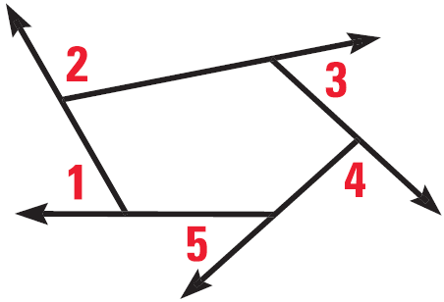
7.1 Angles of Polygons
Polygon Exterior Angles Theorem
Sum of the measures of the exterior angles of a convex polygon 360°
What is the measure of an exterior angle of a regular pentagon?
What is the measure of an interior angle of a regular pentagon?
Try #34
Notes:
$$\frac{360}{5}=72°$$
$$180=x+72$$
$$x=108$$
Or
$$S=\left(5−2\right)⋅180$$
$$S=540$$
$$int angle=\frac{540}{5}=108$$

Slide 10
7.2 Properties of Parallelograms
After this lesson…
• I can prove properties of parallelograms.
• I can use properties of parallelograms.
• I can solve problems involving parallelograms in the coordinate plane.

Slide 11
7.2 Properties of Parallelograms
On scrap paper draw two sets of parallel lines that intersect each other.
Measure opposite sides. How are opposite sides related?
Measure opposite angles. How are opposite angles related?

Slide 12
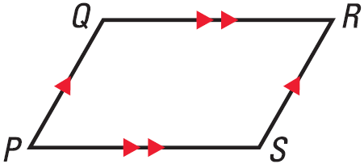
7.2 Properties of Parallelograms
Definition of parallelogram
  Quadrilateral with opposite sides parallel
Opposite sides of parallelogram are congruent
Opposite angles of a parallelogram are congruent
Notes:
Theorems were demonstrated in the focus

Slide 13
7.2 Properties of Parallelograms
Consecutive angles in a parallelogram are supplementary
  Remember from parallel lines (chapter 3) that consecutive interior angles are supplementary
  Draw diagonals on your parallelogram
  Measure each part of the diagonals to see if they bisect each other.
Diagonals of a parallelogram bisect each other

Slide 14
7.2 Properties of Parallelograms
y
Find x, y, and z if the
figure is a parallelogram.
Try #2
20°
z°
42
x°
Notes:
x = 70 Opposite angles of ▱ ≅
y = 42 Opposite sides of ▱ ≅
z = 20 Alternate interior angles thrm

Slide 15
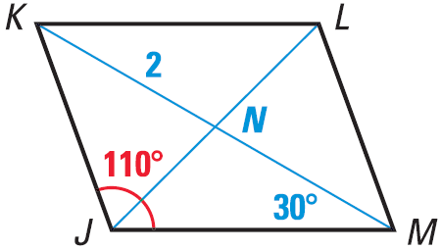

7.2 Properties of Parallelograms
Find NM
Find m$∠$JML
Find m$∠$KML
Try #12
Notes:
MN = NK = 2
m$∠$JML + 110° = 180° → m$∠$JML = 70°
30° + m$∠$KML = 70° → m$∠$KML = 40°

Slide 16
7.2 Properties of Parallelograms
Three vertices of ▱DEFG are D(−1, 4), E(2, 3), and F(4, −2). Find the coordinates of vertex G.
Try #26
Notes:
Graph points. Use rise and run of DE starting at F to find G. Use rise and run of EF to start at D to verify G.
(1, −1)

Slide 17
7.3 Proving That a Quadrilateral Is a Parallelogram
After this lesson…
• I can identify features of a parallelogram.
• I can prove that a quadrilateral is a parallelogram.
• I can find missing lengths that make a quadrilateral a parallelogram.
• I can show that a quadrilateral in the coordinate plane is a parallelogram.

Slide 18
7.3 Proving That a Quadrilateral Is a Parallelogram
Review
What are the properties of parallelograms?
  Opposite sides parallel
  Opposite sides are congruent
  Opposite angles are congruent
  Diagonals bisect each other

Slide 19
7.3 Proving That a Quadrilateral Is a Parallelogram
If we can show any of these things in a quadrilateral, then it is a parallelogram.
  If both pairs of opposite sides of a quad are parallel, then it is a parallelogram (definition of parallelogram)
  If both pairs of opposite sides of a quad are congruent, then it is a parallelogram.
  If both pairs of opposite angles of a quad are congruent, then it is a parallelogram.
  If the diagonals of a quad bisect each other, then it is a parallelogram.
  If one pair of opposite sides of a quad is both parallel and congruent, then it is a parallelogram.

Slide 20
7.3 Proving That a Quadrilateral Is a Parallelogram
Is it a parallelogram?
Try #2
6 cm
6 cm
Notes:
Yes; 1 pair of opposite sides parallel and congruent
No, congruent is not same as parallel

Slide 21
7.3 Proving That a Quadrilateral Is a Parallelogram
For what values of x and y is quadrilateral STUV a parallelogram?
Try #8
Notes:
24 – x = x + 6
24 = 2x + 6
18 = 2x
x = 9
y = 2x + 3
y = 2(9) + 3
y = 21

Slide 22
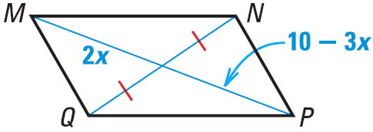
7.3 Proving That a Quadrilateral Is a Parallelogram
Find x so that MNPQ is a parallelogram.
Try #14
Notes:
Diagonals bisect each other
$$2x=10−3x$$
$$5x=10$$
$$x=2$$

Slide 23
7.3 Proving That a Quadrilateral Is a Parallelogram
Show that quadrilateral ABCD is a parallelogram.
Try #16
Notes:
Show the diagonals have the same midpoint (bisect each other)
Or show the opposite sides have the same slope (parallel)

Slide 24
7.4 Properties of Special Parallelograms
After this lesson…
• I can identify special quadrilaterals.
• I can explain how special parallelograms are related.
• I can find missing measures of special parallelograms.
• I can identify special parallelograms in a coordinate plane.

Slide 25
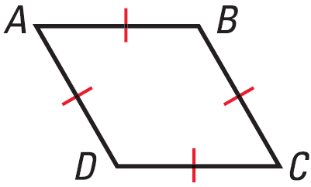
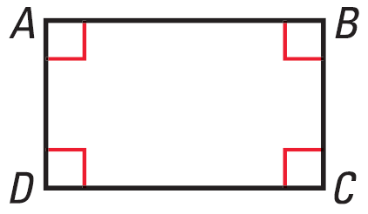
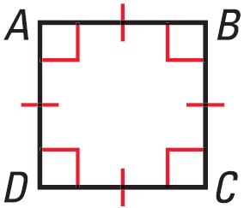

7.4 Properties of Special Parallelograms
All of these are parallelograms
Rhombus
  Four ≅ sides
Rectangle
  Four right $∠$s
Square
  Rhombus and Rectangle
  Four ≅ sides
  Four right $∠$s

Slide 26
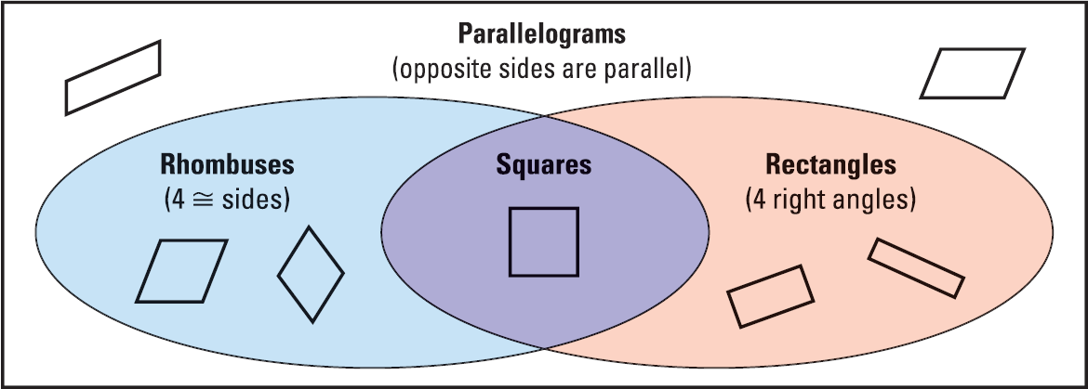
7.4 Properties of Special Parallelograms

Slide 27

7.4 Properties of Special Parallelograms
For any rectangle EFGH, is it always or sometimes true that $\overline{FG}≅\overline{GH}$?
Classify the figure.
Try #2, 8
Notes:
Sometimes, $\overline{FG}$ and $\overline{GH}$ are consecutive sides, not opposite
Rhombus (parallel sides which makes parallelogram; opposite sides are ≅ and adjacent sides are ≅, so all sides are ≅)

Slide 28
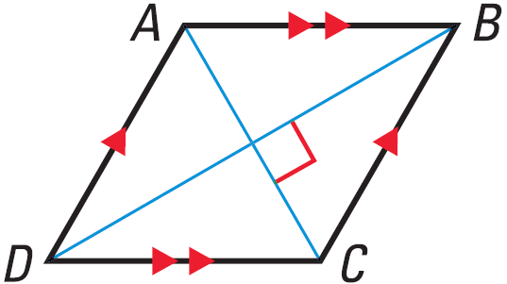
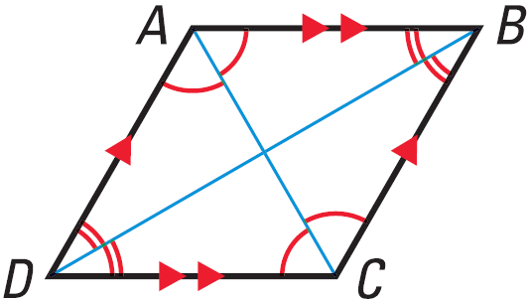
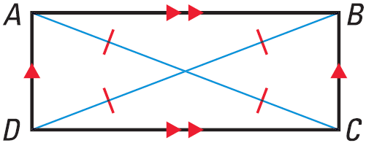
7.4 Properties of Special Parallelograms
Diagonals
Rhombus: diagonals are perpendicular
Rhombus: diagonals bisect opposite angles
Rectangle: diagonals are congruent

Slide 29
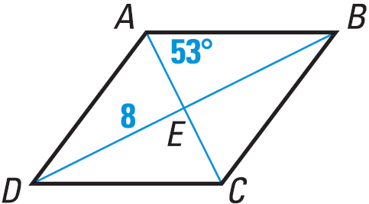

7.4 Properties of Special Parallelograms
ABCD is a rhombus
Find m$∠$BCE
Find m$∠$ABD
Find m$∠$AED
Try #12
Notes:
Opposite angles ≅: m$∠$BCE = 53°
ΔABE is right Δ: m$∠$ABD = 90° − 53° = 37°
Diagonals are ⊥: m$∠$AED = 90°

Slide 30
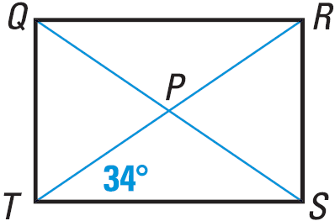
7.4 Properties of Special Parallelograms
In rectangle QRST, QS = 7x − 15 and RT = 2x + 25. Find the lengths of the diagonals of QRST.
Try #24
Notes:
Diagonals of Rectangle are ≅:
$$7x−15=2x+25$$
$$5x−15=25$$
$$5x=40$$
$$x=8$$
$$QS=RT=7\left(8\right)−15=41$$

Slide 31
7.5 Properties of Trapezoids and Kites
After this lesson…
• I can identify trapezoids and kites.
• I can use properties of trapezoids and kites to solve problems.
• I can find the length of the midsegment of a trapezoid.
• I can explain the hierarchy of quadrilaterals.

Slide 32
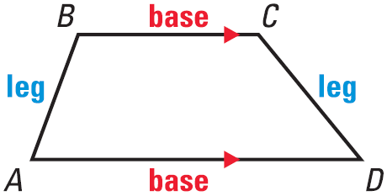
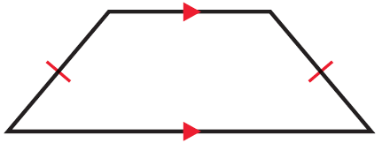
7.5 Properties of Trapezoids and Kites
Trapezoid
  Quadrilateral with exactly one pair of parallel sides
If the legs are ≅, then the trap is isosceles

Slide 33
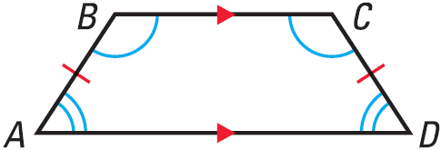
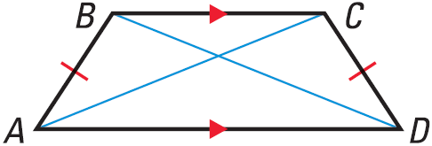
7.5 Properties of Trapezoids and Kites
If isosceles trapezoid, then each pair of base angles is ≅.
If isosceles trapezoid, then diagonals are ≅.
The converses are also true

Slide 34
7.5 Properties of Trapezoids and Kites
Show that ABCD is a trapezoid. Then decide whether it is isosceles.
Try #2
Notes:
Slopes: $m_{BC}=\frac{2−3}{3−0}=\frac{1}{3};m_{AD}=\frac{−3−\left(−1\right)}{4−\left(−2\right)}=−\frac{1}{3}$
Since only 1 pair of sides is ∥, it is a trapezoid
Check for isosceles: $AB=\sqrt{{\left(0−\left(−2\right)\right)}^{2}+{\left(3−\left(−1\right)\right)}^{2}}=\sqrt{20};CD=\sqrt{{\left(4−3\right)}^{2}+{\left(−3−2\right)}^{2}}=\sqrt{26}$
Not isosceles

Slide 35
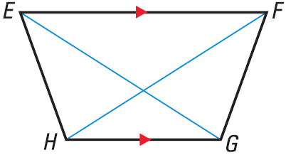

7.5 Properties of Trapezoids and Kites
If the trapezoid is isosceles and m$∠$HEF = 70°, find m$∠$EFG, m$∠$FGH, and m$∠$GHE.
Try #6
Notes:
Base angles are ≅; m$∠$EFG = 70°
Consecutive interior angles are supplementary; m$∠$FGH = m$∠$GHE = 110°

Slide 36
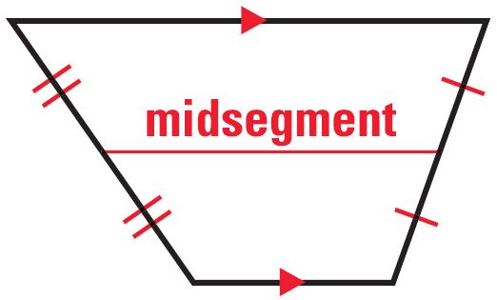
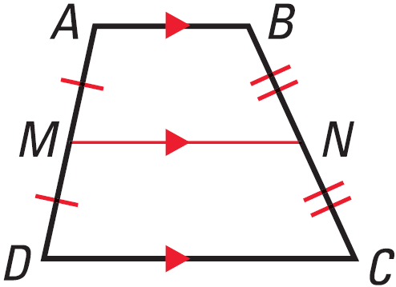
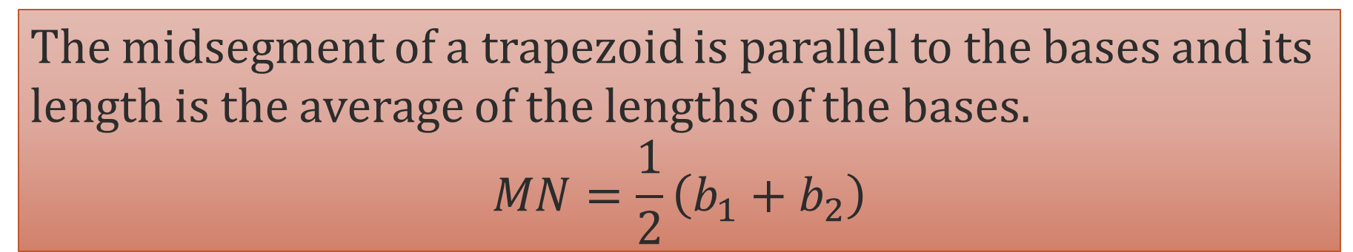
7.5 Properties of Trapezoids and Kites
Midsegment of a Trapezoid
  Segment connecting the midpoints of each leg
Midsegment Theorem for Trapezoids
The midsegment of a trapezoid is parallel to the bases and its length is the average of the lengths of the bases.
$$MN=\frac{1}{2}\left(b_{1}+b_{2}\right)$$

Slide 37

7.5 Properties of Trapezoids and Kites
In trapezoid JKLM, $∠$J and $∠$M are right angles, and JK = 9 cm. The length of the midsegment $\overline{NP}$ of trapezoid JKLM is 12 cm. Find ML.
Try #10
Notes:
$$midsegment=\frac{1}{2}\left(b_{1}+b_{2}\right)$$
$$12=\frac{1}{2}\left(ML+9\right)$$
$$24=ML+9$$
$$ML=15$$

Slide 38
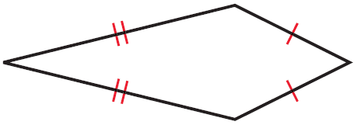
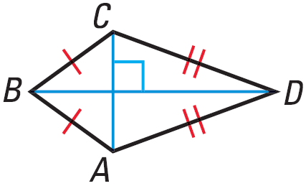
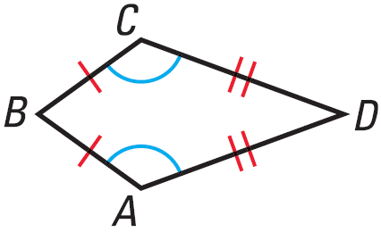
7.5 Properties of Trapezoids and Kites
Kites
  Quadrilateral with 2 pairs of consecutive congruent sides
If kite, then the diagonals are perpendicular.
If kite, then exactly one pair of opposite angles are congruent.

Slide 39
7.5 Properties of Trapezoids and Kites
Find m∠C in the kite shown.
Try #16
Notes:
$$x°+x°+80°+50°=360°$$
$$2x°+130°=360°$$
$$2x°=230°$$
$$x=115°$$

Slide 40
7.5B Classifying Quadrilaterals
After this lesson…
• I can explain the hierarchy of quadrilaterals.

Slide 41
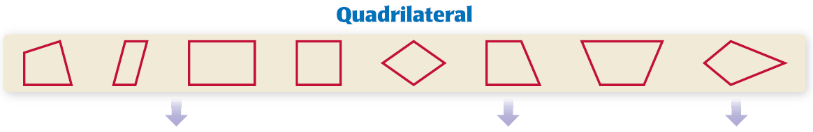
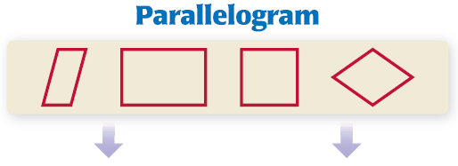
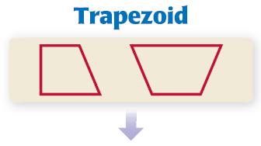
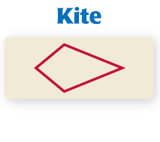
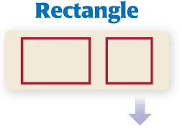
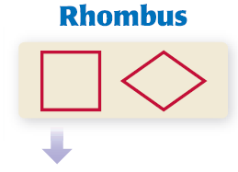


7.5 Properties of Trapezoids and Kites

Slide 42
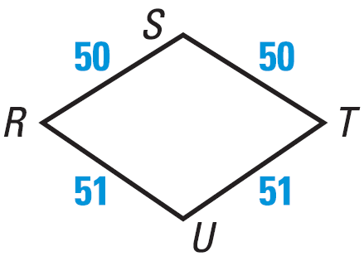
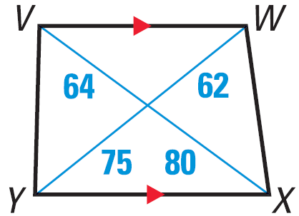
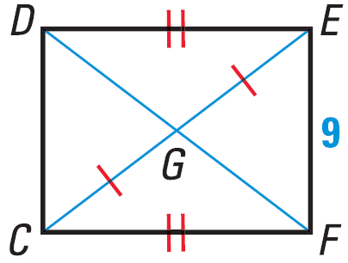
7.5 Properties of Trapezoids and Kites
Give the most specific name for the quadrilateral.
Try #22
Notes:
Kite (≅ consecutive sides)
Trapezoid (exactly one pair of parallel sides, diagonals not ≅)
Quadrilateral (not enough information to be more specific)

